Slide 1
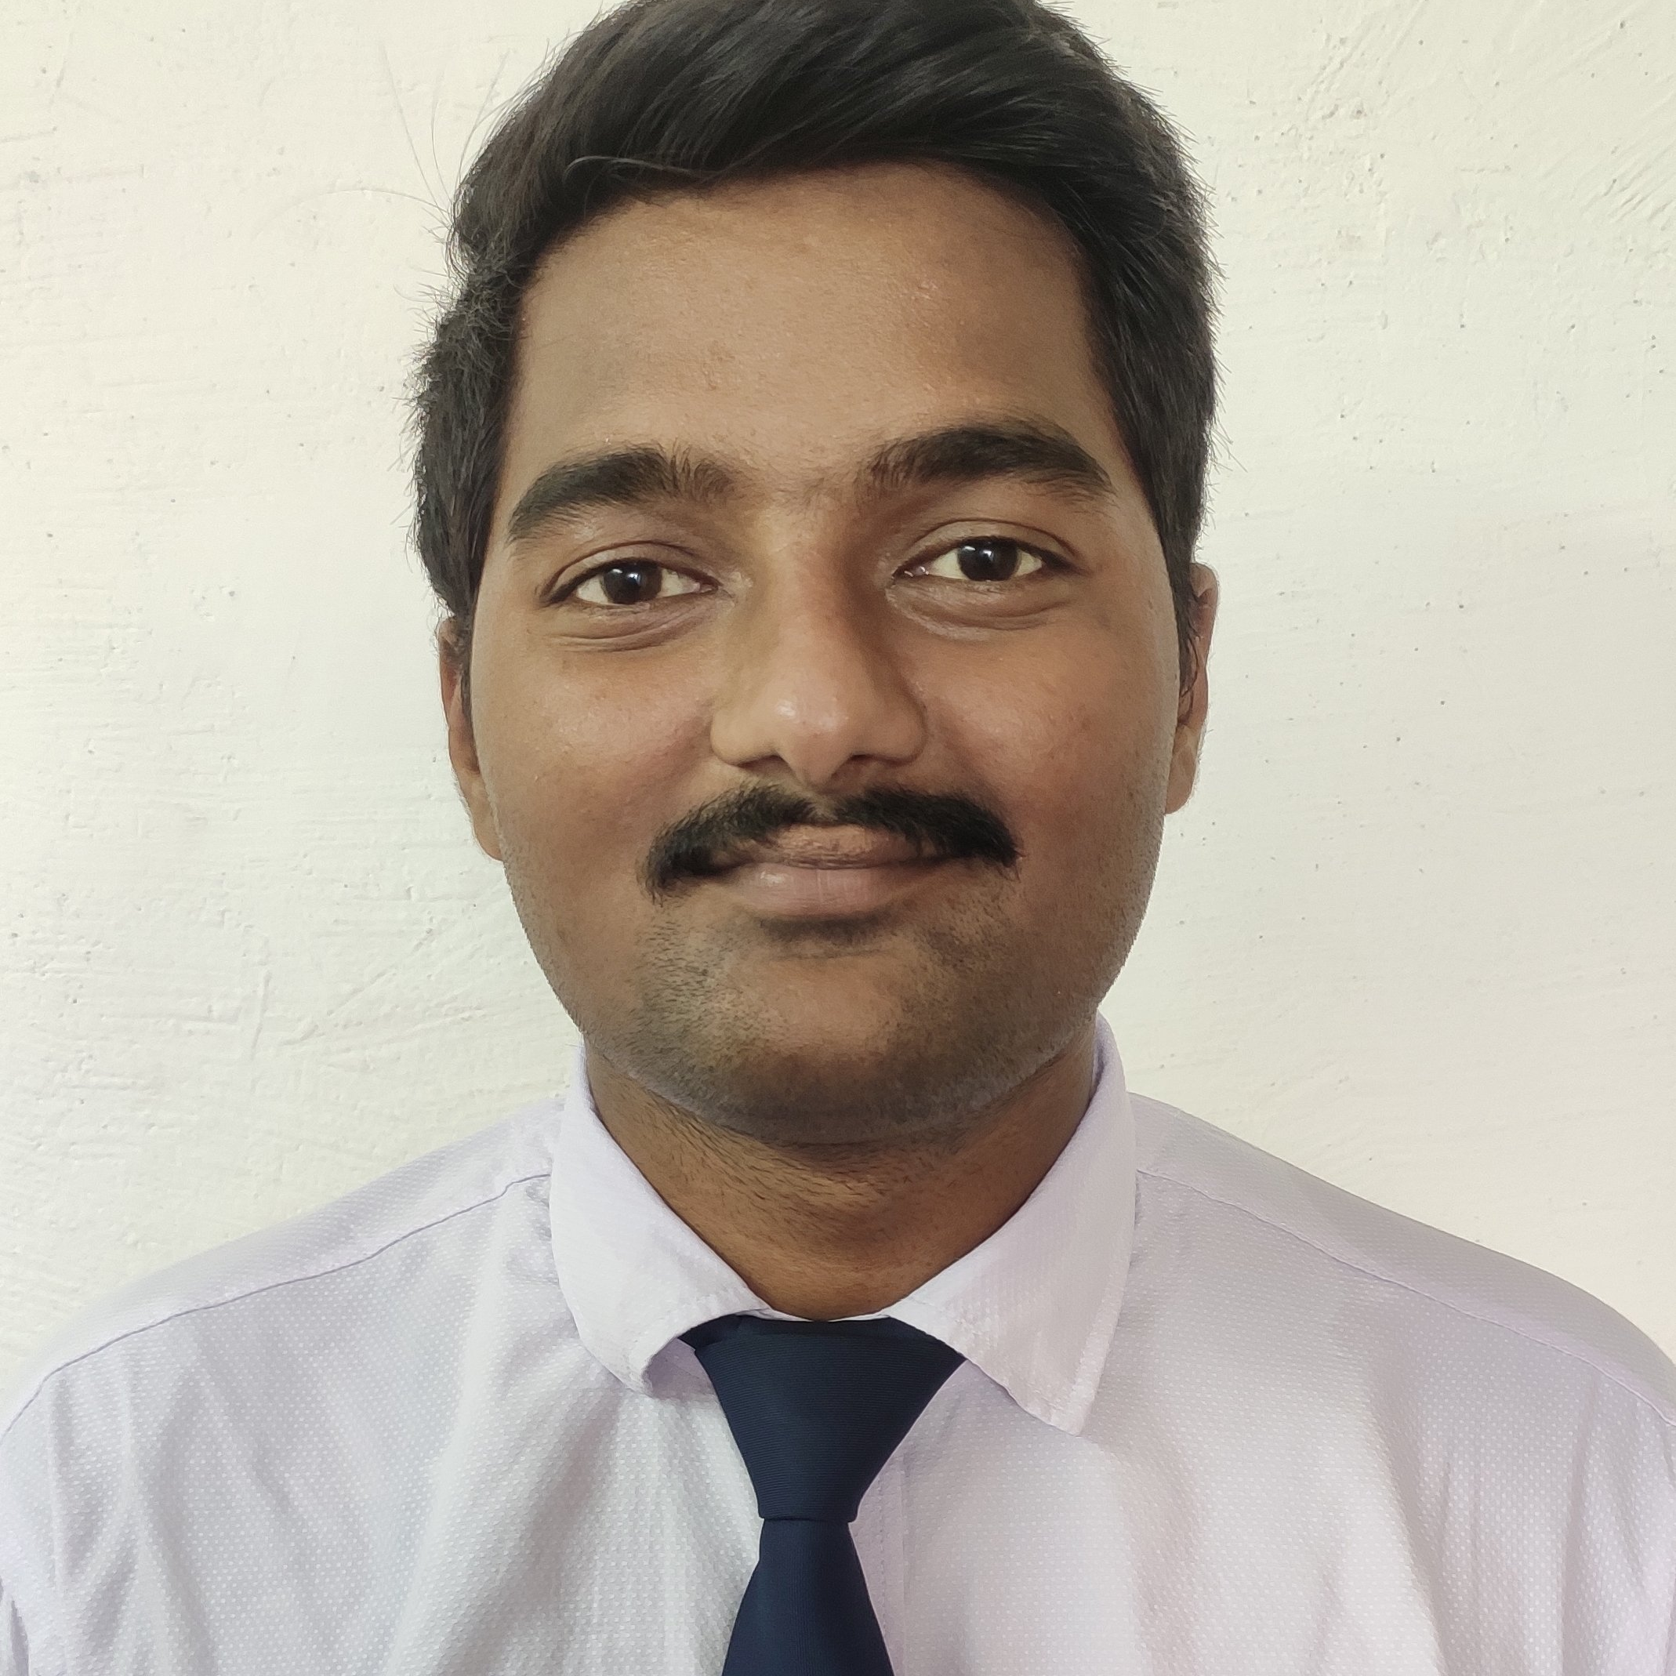
Kandula Lakshmana Rao
Bachelor of Technology in Mechatronics : 2019 - 2023
Analyst / Software Engineer
Skills
Mumbai
ReactJS | Components, Directives, Services, Modules, Routing, Forms & Validation
Spring Boot Microservices | Spring Boot starters, Annotations, Netflix Eureka, Spring Cloud Gateway, Netflix Ribbon & Hystrix
Java | Programming Constructs, OOPS, Exception Handling, Generics, Collections, Annotations, Lambda Expressions & Stream APIs.
Spring Core | IOC Container, Dependency Injection & Annotations
Spring REST | REST Controllers & HTTP methods implementations
Spring Data MongoDB | Implemented MongoRepository Interface using Spring Data MongoDB
Database | SQL Database – Oracle NoSQL Database - MongoDB
UI Tech | HTML5, CSS3, JavaScript, ES6 & TypeScript
Tools | Git, Postman, Maven & Eclipse IDE
Add On skills | C and C++, Teamwork, Team motivation, Team Spirit, Communication & Peer Learning
kandula-lakshmana.a.rao@capgemini.com
+91 8639936578
A4
Full Stack Developer
Hands on experience in creating microservices using ReactJS, Spring Boot, Open Feign, Spring Cloud API Gateway & Eureka Server.
Good Understanding of UI Technology & ReactJS for Frontend development.
Proficient in creating Frontend Web application in ReactJS with Authentication, Template-driven forms, Component Interaction & routing.
Hands on experience in implementing polyglot architecture with ReactJS & Spring Boot.
Hands on experience in unit testing using Mockito.
Implemented ReactJS & Spring Boot in case study and upskilling his knowledge continuously.
Online Railway Booking System Application
Completed end to end of this case study with ReactJS JWT Authentication, Bootstrap & ReactJS are used for user interface. MongoDB and MySQL are used for Database.
Mini Projects done using Arduino & MATLAB
Developed a robot using Arduino and MATLAB which follows a path to travel named “Line Following Robot”.
Developed a robot named “Obstacle Avoidance Robot” using Arduino UNO which detects an obstacle in its path, avoids it and travels.
Developed a Home Automation System using BLYNK APP, NodeMCU, LCD, LDR, HC-04, DHT11, DC Motor and LED.

